Slide 1
Week 6
Domain relational Calculus

Slide 2
Student Objectives
Upon completion of this video, you should be able to:
Write a domain relational calculus expression that requires a join
Show what rows would be returned when given a domain relational calculus expression

Slide 3
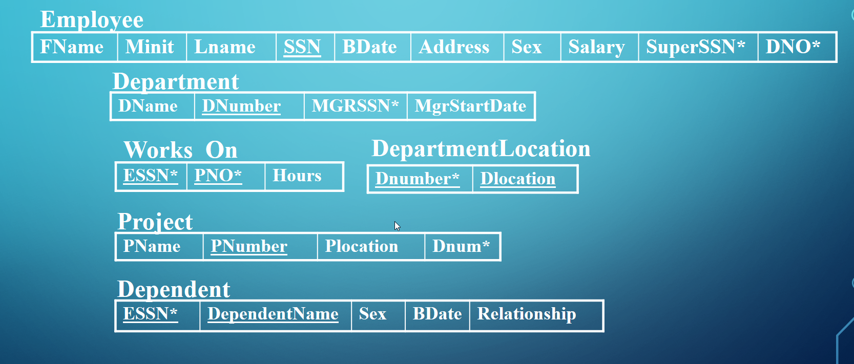
Domain Relational Calculus
In Domain Calculus an expression is of the form:
{x₁, x₂, ...., x_{n}| COND(x₁, x₂, ...x_{n}, x_{n +1}, ....x_{n+m})}
Retrieve the birth date and address of the employee whose name is 'Jon R. Mortensen' :
{u,v | (∃q)(∃r)(∃s) (EMPLOYEE(qrstuvwxyz) and q = 'Jon' and r = 'R.' and s='Mortensen')}
or alternative notation would be:
{u,v | EMPLOYEE('Jon','R.','Mortensen', t,u,v,w,x,y,z)}

Slide 4
Domain Calculus Examples
q r s t u v w x y z
For every project located in 'London', list the project number, the controlling department number, and the department manager's last name.
{i,k,s | (∃j) (PROJECT(hijk) and (∃t)(EMPLOYEE(qrstuvwxyz) and (∃b) (∃c)(DEPARTMENT(abcd) and k=b and c=t and j='London')))}
Find the name of employees who have no dependents
{q,s | (∃t) (EMPLOYEE(qrstuvwxyz) and (not (∃l) DEPENDENT(lmnop) and t=l)))}
OR
{q,s | (∃t) (EMPLOYEE(qrstuvwxyz) and (∀ l) (not ( DEPENDENT(lmnop) or not(t=l)))}
l m n o p
q r s t u v w x y z
a b c d
h i j k

Slide 5
QUESTION: List the names of managers who have at least one dependent:
{q,s | (∃t)(EMPLOYEE(qrstuvwxyz) and (∃c)(DEPARTMENT(abcd) and (∃l)(DEPENDENT(lmnop) and c=t and l=t)))}
q r s t u v w x y z
a b c d
l m n o p

Slide 6
Review
AA
BB
h i j
m n o p
A | B | C
Pig | 22 | Pink
Cat | 22 | Green
Cat | 55 | Blue
A | B | C | D
Pig | 22 | Blue | 14
Cat | 22 | Green | 33
Cat | 22 | Blue | 22
{h| (∃j)(AA(hij) and j=“Pink”))}
A
Pig
{h,m,p| (∃i)(AA(hij) and (∃n) (∃o)(BB(mnop) and i=n and o=“Blue”))}
AA.A | BB.A | D
Pig | Pig | 14
Pig | Cat | 22
Cat | Pig | 14
Cat | Cat | 22

